Slide 1
Linear Regression

Slide 2
Linear Regression in Machine Learning
Linear regression is one of the easiest and most popular Machine Learning algorithms.
It is a statistical method that is used for predictive analysis.
Linear regression makes predictions for continuous/real or numeric variables such as sales, salary, age, product price, etc.
It is a method of Supervised Learning in Machine Learning.

Slide 3
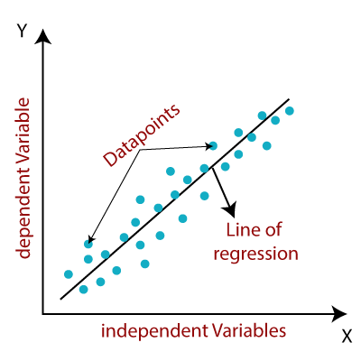
Linear Regression

Slide 4
Linear Regression
y= a₀+a₁x+ ε
Mathematically, we can represent a linear regression as:
Y=a0+a1x+E
Y= Dependent Variable (Target Variable) X= Independent Variable (predictor Variable) a0= intercept of the line (Gives an additional degree of freedom) a1 = Linear regression coefficient (scale factor to each input value). ε = random error

Slide 5
Types of Linear Regression
Simple Linear Regression
Single independent variable or single predictor variable
Multiple Linear Regression
Multiple Independent variables or multiple predictor variables

Slide 6
Linear Regression Line
A linear line showing the relationship between the dependent and independent variables is called a regression line.
A regression line can show two types of relationship:

Slide 7
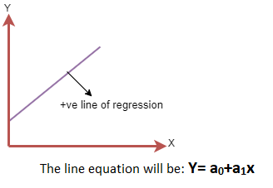
Positive Linear Relationship

Slide 8
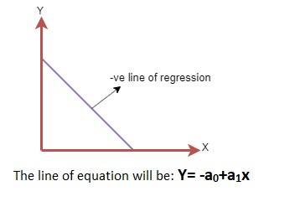
Negative Linear Relationship:

